Slide 1
Mitosis Review
Cell’s Alive Video of Mitosis
* Mitosis cell division. Ex: skin cells make skin cells, liver cells make liver cells, blood cells make blood cells)
2 daughter cells.
* One cell duplicates all of its DNA and Organelles to become_____________
* Are the Daughter Cells Identical to each other?
Yes
* How are they identical to each other?
They have the same DNA

Slide 2
Introduction to Meiosis
Watch the Cells Alive Video of Meiosis:
How does Meiosis differ from Mitosis?
2 cell divisions
4 daughter cells produced
Chromosomes line up in pairs (in 1st metaphase)
Meiosis: The cell division process that makes gametes (egg and sperm)
Where (in your body) does Meiosis occur?
Females: Ovaries make eggs
Egg = the female sex cell
Males: Testes make sperm
Sperm = male sex cell

Slide 3
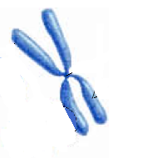
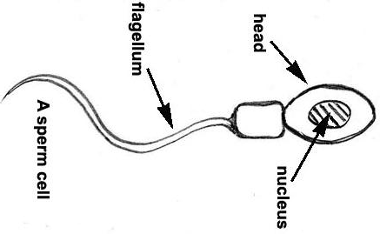
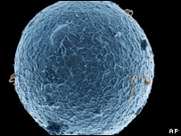
Meiosis Background Information
Most cells have 2 complete sets of Chromosomes
Ex: Human cells have 46 chromosomes (23 pairs)
23 (one set) came from mom’s egg
How many chromosomes
are in your blood cells?
Skin cells?
23 (one set) came from dad’s sperm
46
46
One from Mom
One from Dad
2. The same chromosomes from each set are called homologous chromosomes.
3. Diploid cell (2N) – any cell with 2 complete sets of chromosomes. Body cells
are diploid. Body cells are called somatic cells.
4. Haploid Cell (1N)- a cell with only 1 complete set of chromosomes.
Sex cells ( sperm and egg) are haploid. Sex cells are called gametes.

Slide 4
Homologous Chromosomes
eye color
locus
eye color
locus
hair color
locus
hair color
locus
Paternal
Maternal

Slide 5
Meiosis and Sexual Reproduction
Sexual Reproduction requires meiosis to make gametes which join together during fertilization
46
23
Meiosis Occurs
Fertilization Occurs
Diploid Somatic
Haploid Sperm
46
46
23
Diploid Zygote
Diploid Somatic
Haploid Egg
mitosis
Requires male and female gametes and is usually a slower process than asexual reproduction.
446
46
Embryo

Slide 6
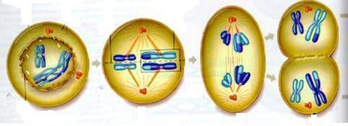
Meiosis I
Cell Division process that makes the gametes.
Prophase I:
-Chromatids pair with homologous pair - forms a tetrad (4 chromatids)
-Crossing over occurs – sections of DNA exchanged
between homologous pairs.
Tetrad
Metaphase I:
- Tetrads line up in the middle
Anaphase I:
- Homologous pairs separate
Telophase I:
Each Cell has identical chromatids still paired
Cytokinesis – cell divides into two

Slide 7
Prophase I
spindle fiber
centrioles

Slide 8
Metaphase I
metaphase plate

Slide 9
Anaphase I

Slide 10
Telophase I

Slide 11
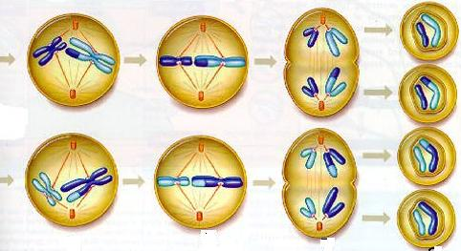
Meiosis II
Occurs like in Mitosis to separate sister chromatids
Prophase II:
- Nucleus disappears and spindle forms
Metaphase II:
- Chromosomes line up in the middle
Anaphase II:
- Chromatids are separated
Telophase II:
4 cells produces
The cells are haploid cells (23 chromosomes)
Each cell is genetically different
These cells are gametes – sperm and egg

Slide 12
Prophase II

Slide 13
Metaphase II
metaphase plate
metaphase plate

Slide 14
Anaphase II
sister chromatids separate

Slide 15
Telophase II

Slide 16
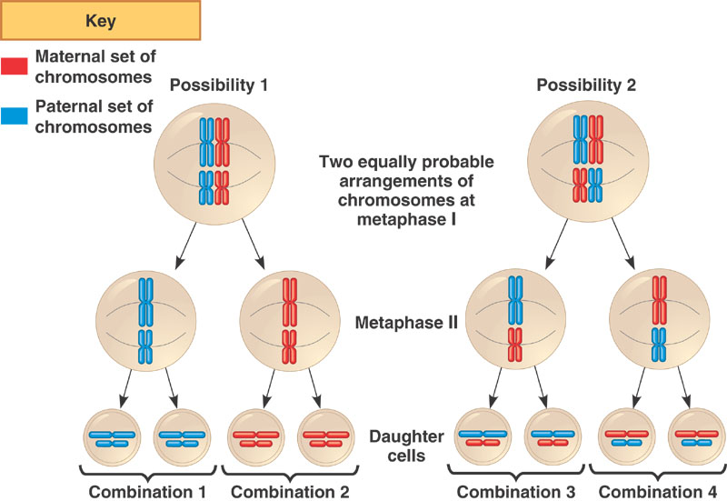
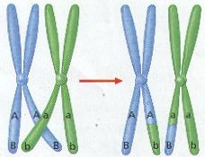
Sexual Reproduction and Genetic Variation
Meiosis creates genetic variation in 2 ways:
Independent Assortment – the position of homologous pairs at metaphase I is a matter of chance.
2. Crossing Over – occurs in prophase I when genes are exchanged between homologous pairs.

Slide 17
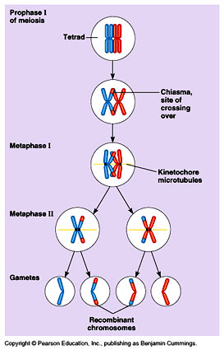
Crossing Over
This process can produce a chromosome that contains a new combination of genetic information from different parents that is called genetic recombination.

Slide 18
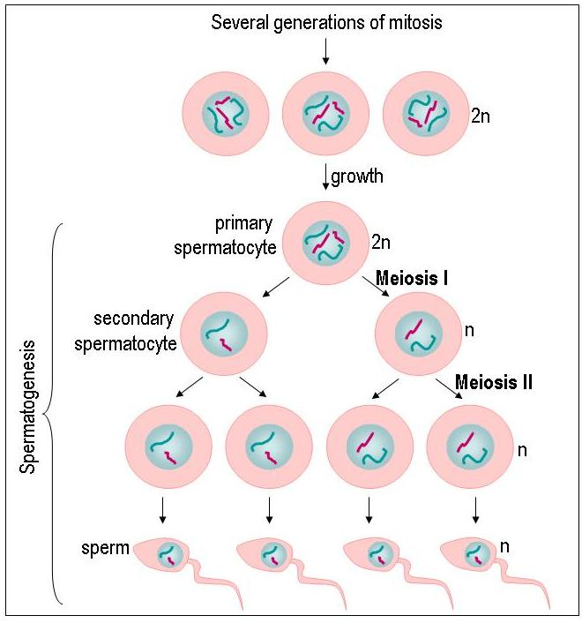
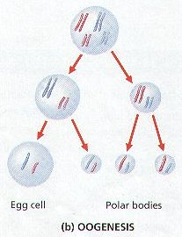
Meiosis in males vs. females
Production of sperm cells
Production of an egg cell

Slide 19
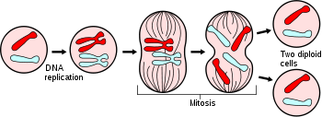
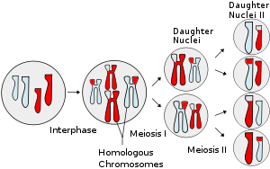
Mitosis
Differences Between Mitosis and Meiosis
2 daughter cells | 4 daughter cells
Diploid | Haploid
1 cell cycle | 2 cell cycles
Genetically Identical | Genetically Different
Meiosis
Similarities Between
Mitosis and Meiosis
Sister Chromatids pair up
Go through the same phases
Forms of Cell division

Slide 20
Variation
Important to population as the raw material for natural selection.
Question:
What are the three sexual sources of
genetic variation?

Slide 21
Answer:
1. crossing over (prophase I)
2. independent assortment (metaphase I)
3. random fertilization
Remember: variation is good!

Slide 22
Question:
A cell containing 20 chromosomes (diploid) at the beginning of meiosis would, at its completion, produce cells containing how many chromosomes?

Slide 23
Answer:
10 chromosomes (haploid)

Slide 24
Asexual Reproduction vs. Sexual Reproduction
Asexual Reproduction:
Sexual Reproduction:
Cells divide by Mitosis
Creates genetically identical offspring (clones)
Works best to create stable, unchanging environments
Helps a population colonize an area quickly
Examples:
Yeast cells – budding
Bacteria – binary fission
Cells divide by Meiosis
Meiosis creates genetic variation
Independent Assortment
Crossing Over
Genetic Variation is good in a changing environment.
Requires male and female gametes and is slower than asexual reproduction.
*Because of what happens in meiosis, the same sperm/egg will never be made twice and therefore: There never was nor will there ever be another you! You are genetically unique!
(Except identical twins)

Slide 25
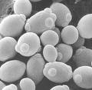
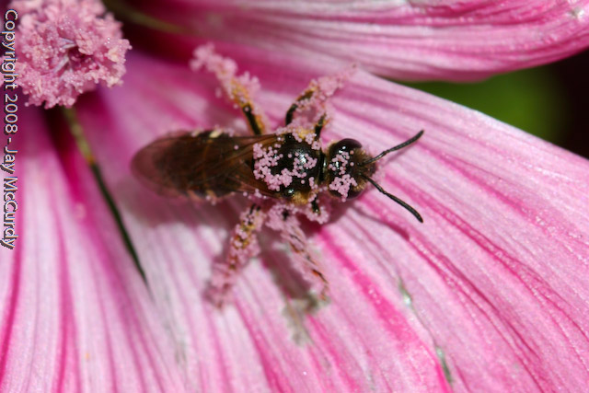
Budding - Asexual
Binary Fission - Asexual
Pollination - Sexual

Slide 26
History of Genetics
Genetic Terms:
Dominant – Represented by a capital letter and masks the recessive allele. T=tall
Recessive – Represented by a lower case letter and is masked by a dominant allele. t=short
Phenotype – outward appearance of the trait. Ex. Tall
Genotype – genetic combination of the trait. Ex. TT, Tt, tt
Homozygous – genotype having the same two alleles. TT or tt
Heterozygous – genotype having two different alleles. Tt
Example: T=tall and t=short
Homozygous tall ________
Homozygous short ________
Heterozygous tall ________
TT
tt
Tt

Slide 27
How do you predict what offspring will look like?
Punnett Square - tool used to predict genotype and phenotype of offspring
Example:
T=Tall t = short
Mom – Tt Dad- Tt
Cross parents
Tt x Tt
mom dad
Draw box
Put mom gametes on top. Put Dad gametes on side.
Fill in box with a letter from each parent
Analyze
Since you have 2 alleles (different versions of a gene) for each gene, you have 2 letters
TT → homozygous dominant (Tall)
tt → homozygous recessive (short)
Tt → heterozygous (tall)
Big letter ALWAYS wins
Genotype Phenotype
Combo of alleles
TT Tt tt
Physical trait
Tall, short
T t
Phenotype Ratio:
75% Tall, 25% short
T
t
TT
Tt
Genotype Ratio:
25% TT, 50% Tt, 25% tt
Tt
tt

Slide 28
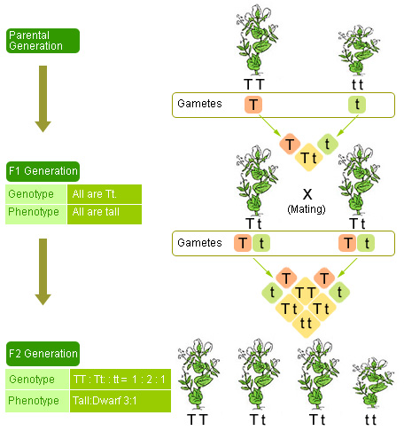
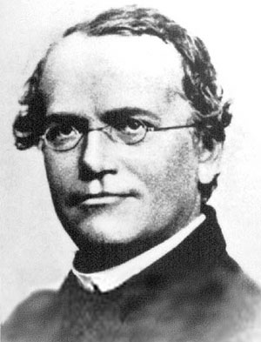
Mendelian Genetics
Gregor Mendel – the father of Genetics
1. Studied garden pea plants
2. He wanted to find out how traits were passed from parent to offspring .

Slide 29
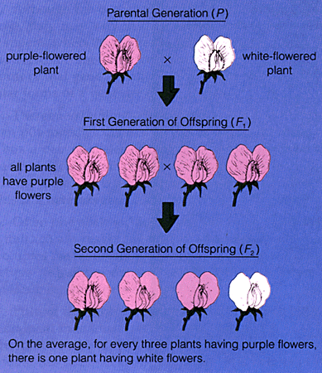
Mendelian Genetics
tt
Mendels Experiments:
TT
1st Experiment:
1. Crossed two true-breeding plants. Ex. Purple flowering plant and a white flowering plant. What are the genotypes?
2. This experiment produced all purple flowering plants. What are the genotypes?
Tt
2nd Experiment:
1. Crossed two of the purple flowering plants from experiment #1.
2. Experiment produced purple flowering & white flowering plants
Purple x White (P generation)
All Purple Offspring (F1 generation)
¾ purple and ¼ white flowers (F2)
Conclusions:
Each plant contained 2 alleles for each trait.
Some genes were stronger or dominant
Some genes were weaker or recessive

Slide 30
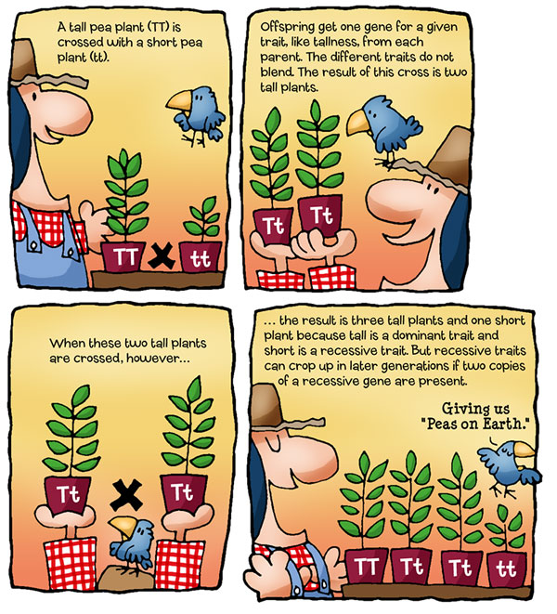

Slide 31
Haploid / Diploid Practice
1. If the gamete has 25 chromosomes, how many chromosomes will the body cells have?
2. If the somatic cells have 20 chromosomes, how many chromosomes will the sex cells have?
3. If the diploid number of chromosomes is 46, what is the haploid number?
4. If the egg cell of a mouse has 12 chromosomes, how many chromosomes will the skin cells have?
5. If the haploid number of chromosomes is 35, how many chromosomes will the somatic cells have?
6. Which type of cell division makes diploid cells?
7. Which type of cell division makes haploid cells?
8. How many pairs of chromosomes do humans have?
50
10
23
24
70
Mitosis
Meiosis
23

Slide 32
Mitosis Review
* Mitosis ________________________. Ex: skin cells make skin cells, liver cells make liver cells, blood cells make blood cells)
* One cell duplicates all of its DNA and Organelles to become_____________
* Are the Daughter Cells Identical to each other? __________
* How are they identical to each other? _______________________

Slide 33
Meiosis Background Information
1. Most cells have ________________________
Ex: Human cells have ______________________
___ (one set) came from mom’s egg
How many chromosomes
are in your blood cells? ____
skin cells? ____
___ (one set) came from dad’s sperm
One from Mom
One from Dad
2. The same chromosomes from each set are called _______________________.
3. _______________– any cell with 2 complete sets of chromosomes.
_________________are diploid. Body cells are called _______________.
4. ______________- a cell with only 1 complete set of chromosomes.
Sex cells are __________. Sex cells are called _____________

Slide 34
Meiosis and Sexual Reproduction
Sexual Reproduction requires meiosis to make gametes which join together during fertilization
Meiosis Occurs
Fertilization Occurs
Diploid Somatic
Haploid Sperm
Diploid Zygote
Diploid Somatic
Haploid Egg
mitosis
Requires male and female gametes and is usually a slower process than asexual reproduction.
446
Embryo

Slide 35
Meiosis I
Cell Division process that makes the __________________.
Prophase I:
-Chromatids pair with ______________ pair - forms a _____________(4 chromatids)
-_____________occurs – sections of DNA exchanged
between homologous pairs.
Tetrad
Spindle
Metaphase I:
-
Anaphase I:
-
Telophase I:
Each Cell has identical ________________________
Cytokinesis – cell divides into two

Slide 36
Meiosis II
Occurs like in _____________ to separate ________________
Prophase II:
-
Metaphase II:
-
Anaphase II:
-
Telophase II:
___________ are produced
The cells are ____________(23 chromosomes)
Each cell is genetically ____________
These cells are ___________– sperm and egg

Slide 37
Sexual Reproduction and Genetic Variation
Meiosis creates _______________________in several ways:
Independent Assortment – ___________________________________
Option 1
Option 2
Crossing Over – ____________________________________________
_____________________________________________________________
This process can produce a chromosome that contains a new combination of genetic information from different parents that is called _____________________________.

Slide 38
Mitosis
Differences Between Mitosis and Meiosis
Meiosis
Similarities Between
Mitosis and Meiosis

Slide 39
Asexual Reproduction vs. Sexual Reproduction
Asexual Reproduction:
Sexual Reproduction:
Cells divide by _________
Creates genetically ____________offspring (clones)
Works best to create __________, __________
environments
Helps a population colonize an area _______
Examples:
Yeast cells – budding
Bacteria – binary fission
Cells divide by ____________
Meiosis creates ___________ ______________
Independent Assortment
Crossing Over
Genetic Variation is good in a ____________ environment.
Requires __________gametes and is _________ than asexual reproduction.
*Because of what happens in meiosis, the same sperm/egg will never be made twice and therefore: There never was nor will there ever be another you! You are genetically unique!
(Except identical twins)

Slide 40
History of Genetics
Genetic Terms:
Dominant – ___________________________________ ( )
Recessive – __________________________________ ( )
Phenotype – _________________________________ ( )
Genotype – _______________________________( )
Homozygous – _____________________________ ( )
Heterozygous – _________________________________( )
Example: T=tall and t=short
Homozygous tall __________________
Homozygous short ________________
Heterozygous tall _________________

Slide 41
Since you have 2 alleles (different versions of a gene) for each gene, you have 2 letters
TT → homozygous dominant (Tall)
tt → homozygous recessive (short)
Tt → heterozygous (tall)
Big letter ALWAYS wins
Genotype Phenotype
How do you predict what offspring will look like?
Punnett Square - ___________________ __________________________________
Example:
T=Tall t = short
Mom – Tt Dad- Tt
Cross parents
______ x _______
Draw box
Put mom gametes on top. Put Dad gametes on side.
Fill in box with a letter from each parent
Analyze
Phenotype Ratio:
Genotype Ratio:

Slide 42
Mendelian Genetics
Gregor Mendel – ________________________________
1. Studied _____________________________
2. He wanted to find out how traits were passed from ___________ to ______________________
Mendels Experiments:
1st Experiment:
1. _______________________________Ex. Purple flowering plant
and a white flowering plant.
2. This experiment produced __________________________
2nd Experiment:
1. Crossed two of the ____________________from experiment #1.
2. Experiment produced _______________& ______________plants
Purple x White (P generation)
All Purple Offspring (F1 generation)
¾ purple and ¼ white flowers (F2)
Conclusions:
__________________________________
__________________________________
__________________________________

