Slide 1
Immune System

Slide 2
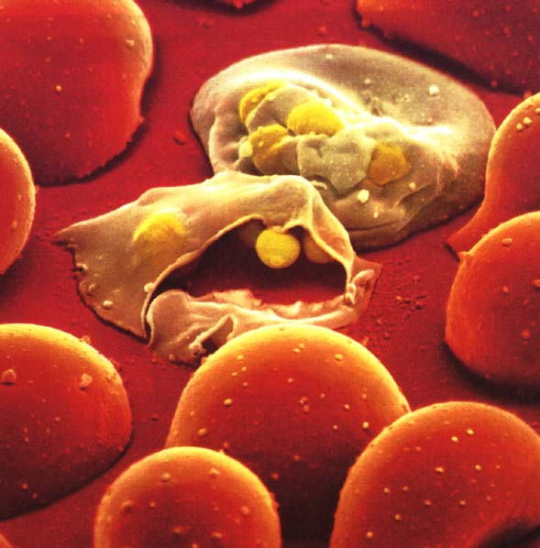
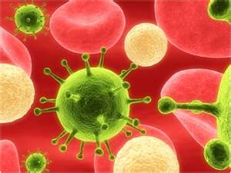
Pathogens: Disease-causing agents
Examples:
Viruses, Bacteria, Protist, Fungus
Main sources of pathogens are:
Soil
Contaminated Water
Infected Animals
People
Malaria protist releasing spores
Viral infection

Slide 3
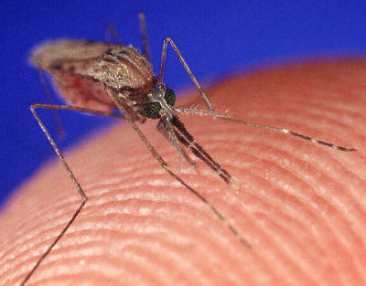
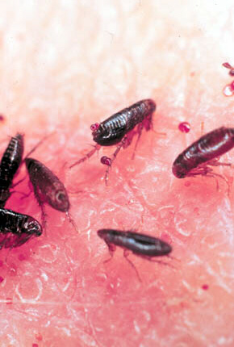
Vectors for Pathogens
Pathogens can be transmitted by
Air, direct contact, an object, or by a vector
Most common vectors are insects
Malaria is spread by mosquitoes
Lyme disease spread by ticks
Bubonic plague spread from rats to humans by fleas

Slide 4
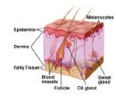
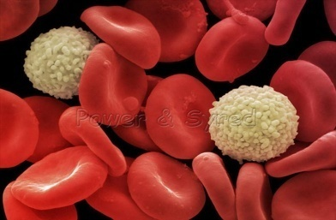
Non-Specific Defenses
First Line of Defense
The skin is the most important barrier against infection. Very few pathogens can penetrate the layers of the skin.
The Second Line of Defense
If pathogens enter the body you get an…
Inflammatory response - nonspecific reaction to tissue damage, produces white blood cells to fight infection.
-Your blood vessels dilate (area becomes red and swollen) to allow more blood flow to the area and more white blood cells move in to engulf and destroy bacteria.

Slide 5
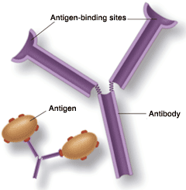
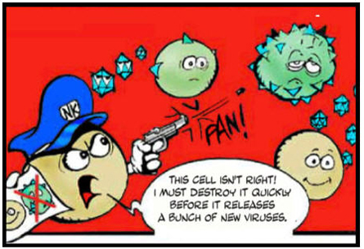
Specific Defenses
Antigens - proteins found on the surface of pathogens (bacteria, viruses, fungi, pollen) that cause an immune response.
Antibodies - proteins found on the surface of white blood cells that attach to an antigen
Antibodies recognize and binds to it like a lock and key
Video Clip – inside ralphie - http://app.discoveryeducation.com/player/view/assetGuid/84B4AA21-9667-4193-B46A-9CDE36DB9E64

Slide 6
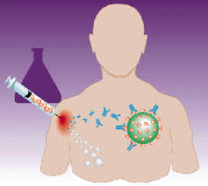
Active Immunity
Active Immunity – type of immunity produced by the body’s response to a vaccine/exposure to a pathogen.
Vaccination – injection of a mild or weakened form of
a pathogen.
- vaccine stimulate the bodies immune system to make millions of antibodies.
ex. Smallpox vaccines, chickenpox vaccine
Vaccine video - http://app.discoveryeducation.com/player/view/assetGuid/163D7D9F-78CF-4905-B94A-D836C7B330B6
This type of immunity is permanent! You are
protected from this disease for the rest of your life.

Slide 7
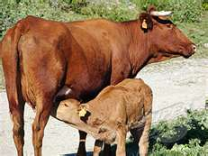
Passive Immunity
Passive Immunity – short term, antibodies produced in another animal and then passed to humans
- ex. mother’s passing antibodies across the placenta or through breast milk
Only lasts a short time because the immune system does not learn how to make the antibodies!

Slide 10
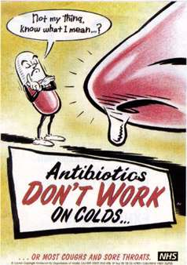
Treatments
Antiobiotics – kills or slows down the growth of bacteria
When antibiotics are not properly used, it can lead to antibiotic resistance.
Anti-viral – does not destroy virus, but slows down the production of new viruses
how the flu invades a cell and how the antiviral (Tamiflu) works to stop it (I would mute it and read the steps to the class) http://www.youtube.com/watch?v=0qCTyKrhVWc
why antivirals are important http://www.youtube.com/watch?v=WaU9cJ4V1i4

